Slide 1






Expressions: The Studio
THE HACKATHON
JOURNEY
Where Ideas Come Alive
Innovate Create Inspire

Slide 2

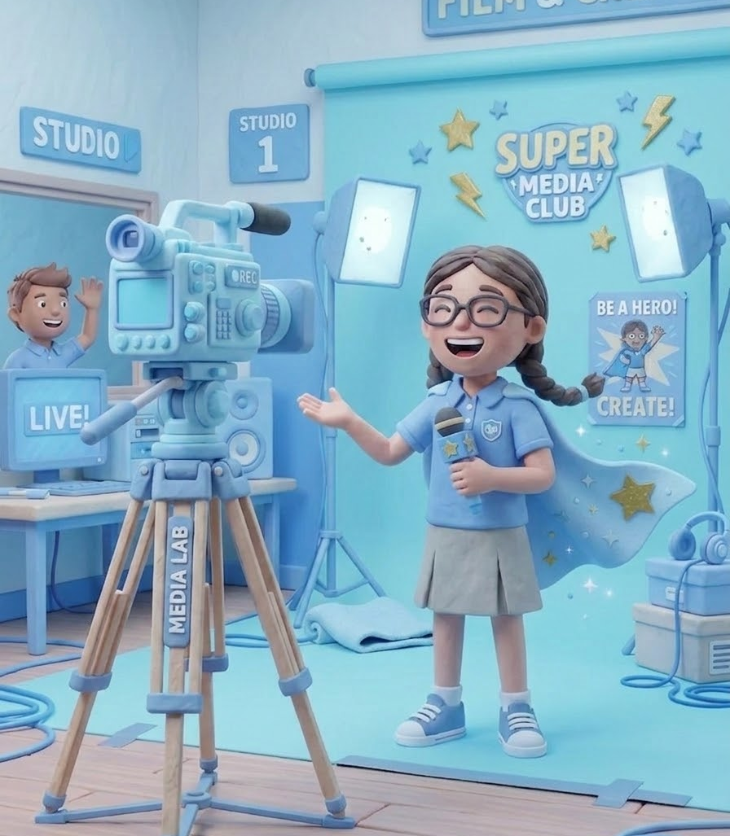




Expressions: The Studio
Name of the Student
{{NAME}}
Grade & Section
{{CLASS}}-{{SECTION}}
Studio
Video Production
Theme
{{THEME}}
Session
2026-27

Slide 3


Week 1 : Understanding the Challenge
Exploration & Ideation

Slide 4

Week 2 : Showcasing the Skills
Focused Learning of required Tools & Techniques

Slide 5










Week 3 : Create and Build
Bringing Ideas To Life- Project Development

Slide 6


Week 4 : Creation and Refinement
From ideas to a single vision- Turning Ideas into Possibilities

Slide 7

Week 5 : Mission Accomplished
Shaping the Final Creation

Slide 8


The Journey in Their Own Words

Slide 9









Thank You
Celebrating Creativity
& Innovation

